Slide 2
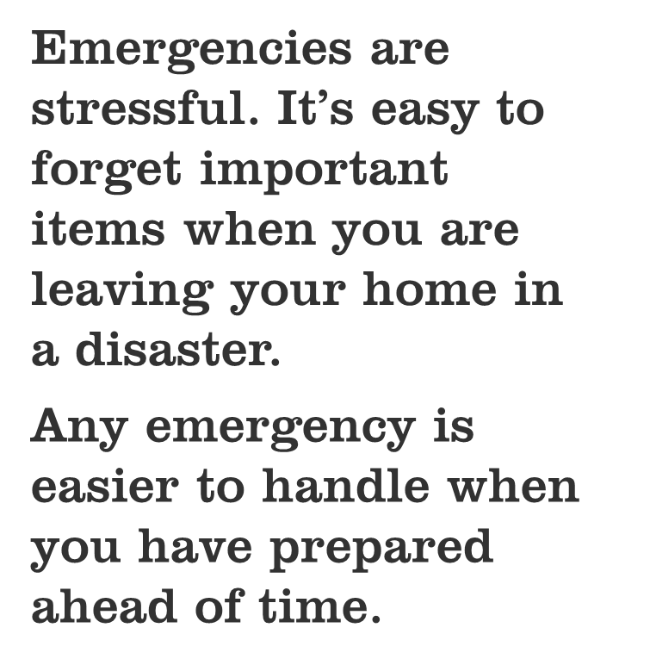
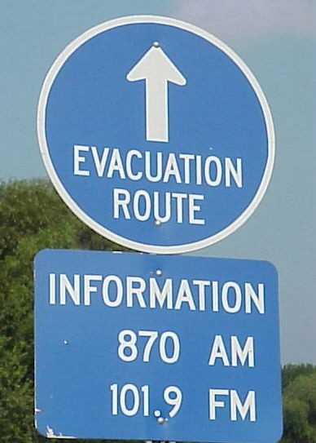
Notes:
Members of your group may or may not have already made an emergency kit. If they have, ask them for examples of things that they have put in their kit.

Slide 3
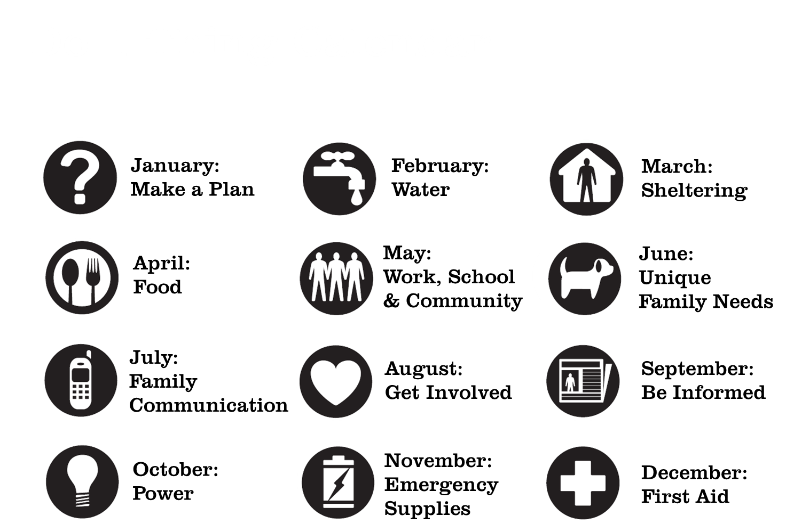

Slide 4
Whether you are told to evacuate or to stay in your home in a disaster, emergency supplies are important
Many items may be in short supply in a disaster: flashlights, batteries, bottled water, etc.
Stores may be closed or not be able to be resupplied
Notes:
Evacuations can happen anywhere, but If your area is prone to hurricanes, wildfires, earthquakes or other events that can call for evacuations, this unit is even more important.
High-hazard areas like floodplains are also at high risk for evacuation

Slide 5
Make a go bag in case you need to evacuate
Create an emergency supply kit for your pet, your car, your workplace or your school
Stash some cash in case ATMs and credit card machines aren’t working

Slide 6
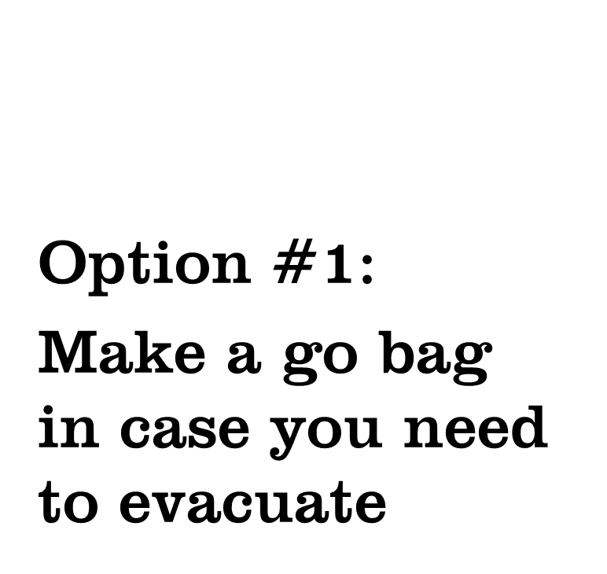
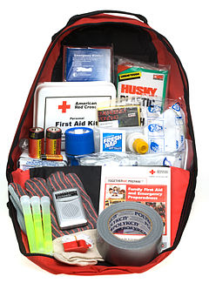
Notes:
Image shows a pre-made bag from the Red Cross. General items are good, but make sure your bag has the things that you and your loved ones need.
If you decide to buy a pre-made bag, make sure you go through it with family members so that everyone knows what is inside. Add whatever other items you will need to the bag.

Slide 7
Portable – Light enough to carry
Important items
Personal items
Hard to replace items
What can you not do without for 24 hours? For three days?

Slide 8
Go Bag
Important | Personal | Hard to replace
Prescriptions (or prescription list) | Toothbrush and toothpaste | Spare glasses or contact lenses
Credit card list and insurance information | Snacks | Hearing aid batteries
Flashlight | Extra clothing | Special items (diapers, baby formula, special dietary items, pet items, etc.)
First aid kit | Comfort items
Notes:
These are just some of the items they should consider. Give the group a chance to talk about what else they might put in their go bag. They might also create a separate list of items that don’t fit or can’t be placed in the go bag because they’re needed every day, but which they will want to take with them if they evacuate.

Slide 10
First aid kit
Flashlight or light sticks
Flares or reflective cones
Blanket
Cell phone charger
Jumper cables and basic tools
Help flag
Nonperishable snacks and bottled water
Notes:
Let members of the group know that pre-packaged car emergency kits are available. Like pre-made go bags, if they decide to purchase one they should take the time to open it up and go through it with all the drivers in their household so that they are familiar with what is in it. They should also add items to meet their own needs.

Slide 11
Plastic bowls (collapsible bowls store more easily)
Pet food and treats
Comfort items
Litter box and bag of litter or waste bags
Medications and copies of vet records
Extra leash and collar
Pet first aid supplies

Slide 12
Pets & Evacuation
If you’re pet isn’t a regular traveler, practice how you would evacuate them
Have a picture of your pet and ID information in case you are separated
Most emergency shelters don’t allow pets
Know what hotels in your area take pets
Make a plan for you and your pets to stay with friends or family if you have to leave your home
Find out if your community has plans for pet emergency sheltering
Microchip your pets!
Notes:
Some pets don’t travel regularly and may be harder to evacuate than others. Practicing ahead of time can identify problems that are easier to solve today than in the middle of a disaster.

Slide 13
First aid supplies
Flashlights or light sticks
Building emergency procedures
Building maps showing evacuation and shelter areas
Pens/pencils
“All Clear” and “Need Help” signs
Clipboard with class/staff names
Notes:
If your school or workplace doesn’t have an emergency kit, offer to help build one, or make a personal kit to keep in your desk or locker.

Slide 14
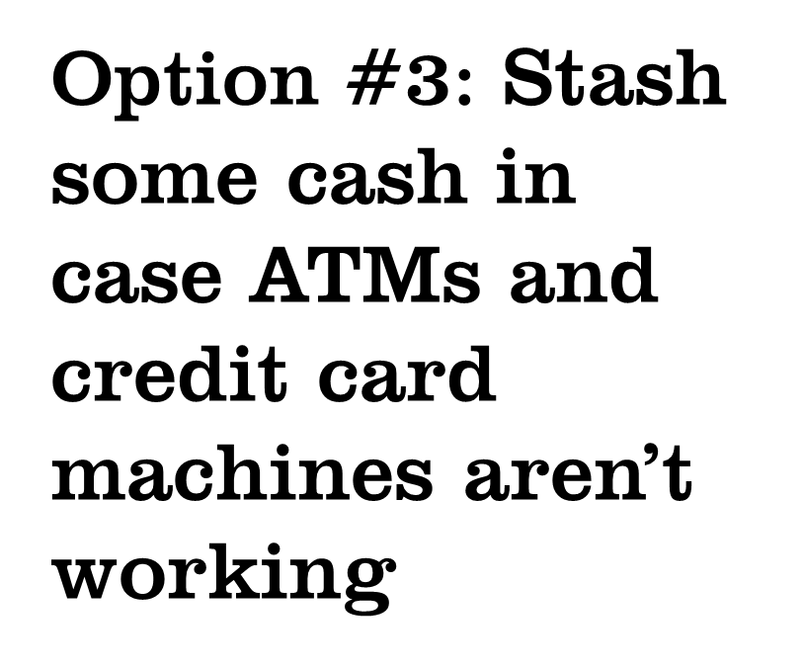
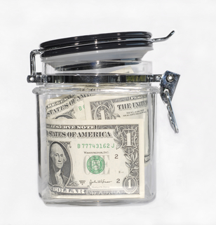

Slide 15
Keep a list of credit card information in your go bag
Include phone numbers where you can report the cards missing if necessary
Put a book of blank checks in your go bag

Slide 16
In a disaster:
Your employer may not be open for business
You may not be able to get to work
Your paycheck may be delayed
You may have unexpected expenses (repairs, hotel bills, etc.)

Slide 17
Federal assistance is only available if a Presidential Disaster Declaration is issued
Assistance payments average a few thousand dollars
Low-interest loans are the most common form of federal disaster assistance
Charitable organizations like the Red Cross and Salvation Army may also provide some assistance

Slide 18
Insurance is the best way to make sure you will have the money you need to repair or replace your belongings after a disaster
Regular homeowners or renters insurance doesn’t cover flood damage
Basement flood rider covers back up from drains and sewers
Flood insurance policy covers flooding from any other source
Notes:
Anybody can buy flood insurance. It’s available for a few hundred dollars a year outside of the floodplain. Remind your group that flooding from heavy rain can happen anywhere.

Slide 19
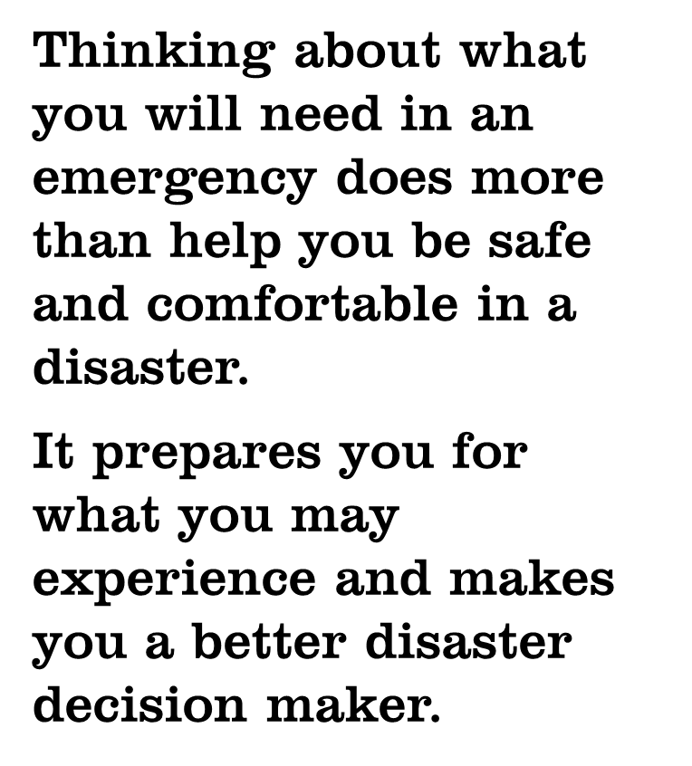
Notes:
Blooms taxonomy (image) shows our levels of thinking. During an emergency we live in the bottom half of the pyramid. We can remember, understand, and apply what we have learned, but it’s harder to think clearly and try to solve problems you have never experienced before in the stress and pressure of an emergency.
Planning for an emergency is on the top half of the pyramid and its something we have to do ahead of time, when we’re calm and not rushed. Once we have a plan we can remember, understand and apply it when it’s needed.

Slide 20
Make sure you have first aid kits and know how to perform basic first aid
Know what to do while you are waiting for an ambulance to arrive

Slide 21
Presenter’s name
Contact Information
Contact Information
Do 1 Thing
http://www.do1thing.com
Email: contact@do1thing.com

