Slide 2
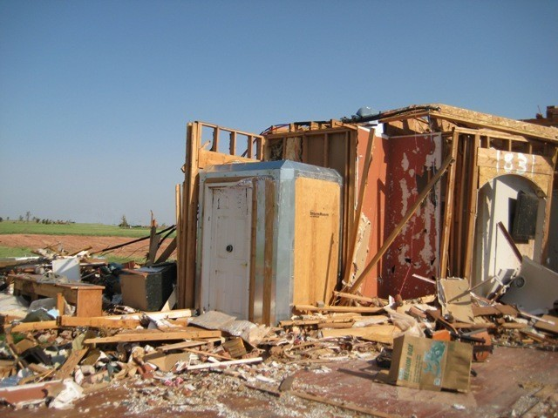
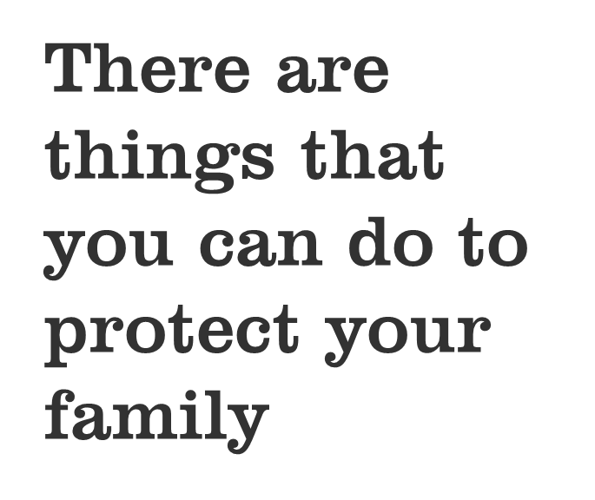

Slide 3
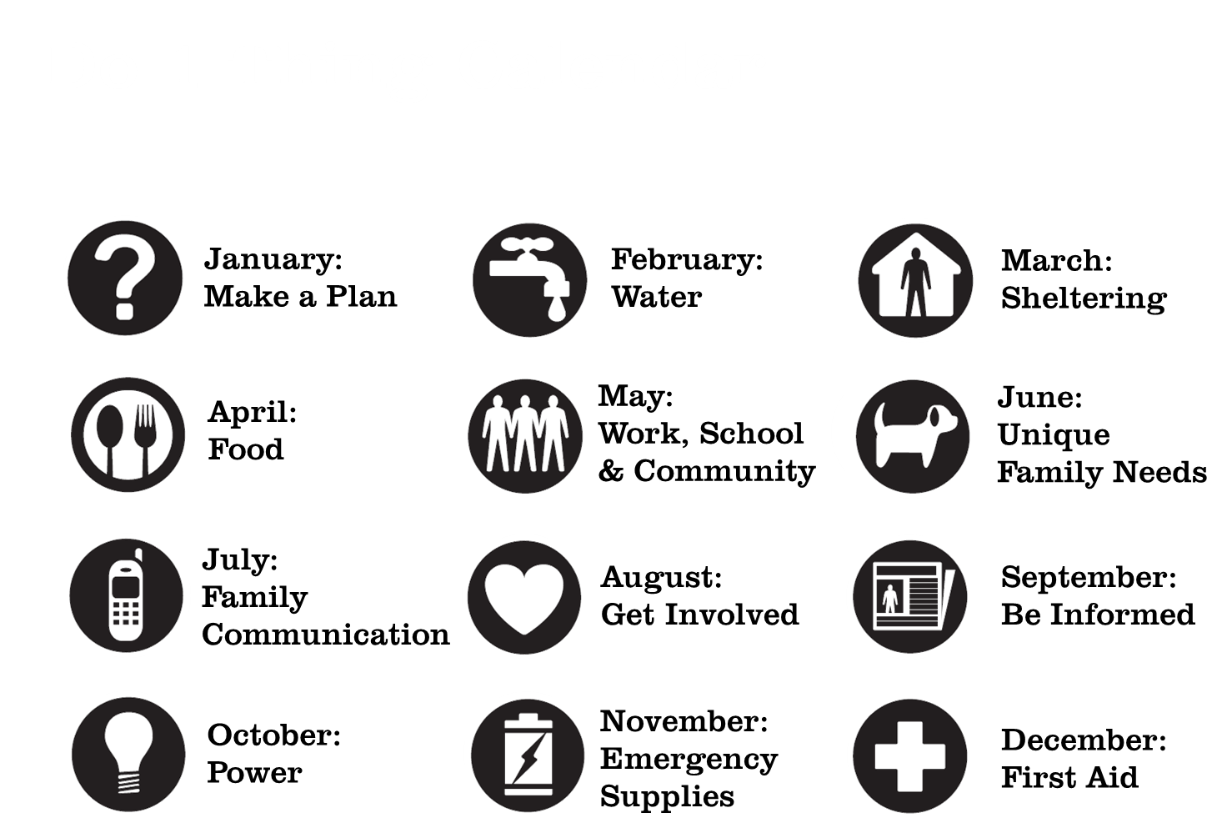

Slide 4
Why shelter?
In a disaster you may be asked to either evacuate or shelter in place.
In the excitement of an emergency it can be difficult to focus on what you are doing.
Know what to do to keep your family safe.
Practice tornado and fire safety plans.
If your family has practiced they will be more comfortable doing it when the emergency actually happens.

Slide 5
Choose one thing to do this month
Identify the best storm shelter in your home and practice getting to the shelter with your family.
Learn how to safely shelter in place.
Make a Go Bag for emergency sheltering.

Slide 6
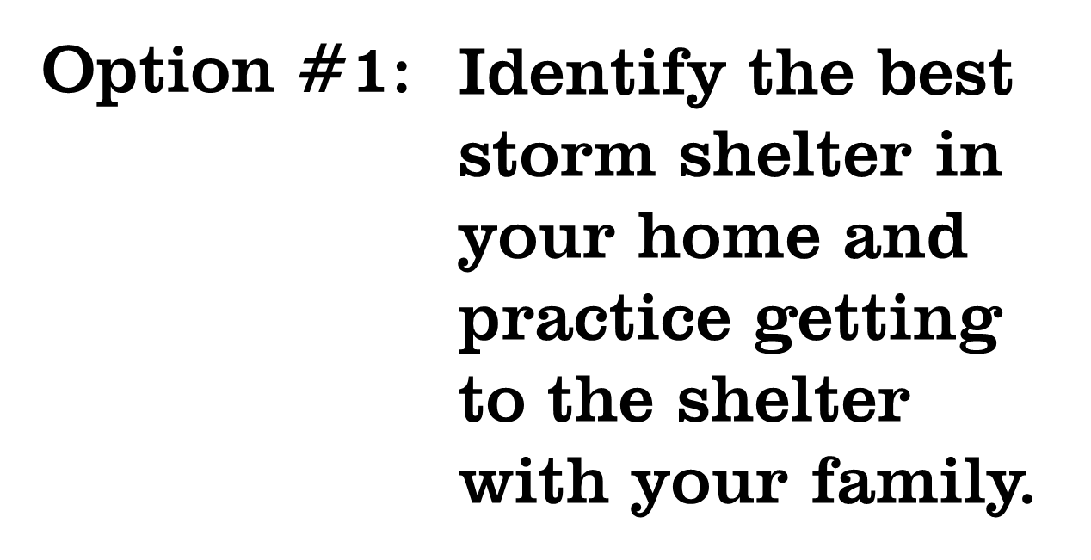
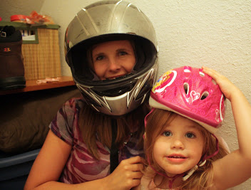

Slide 7
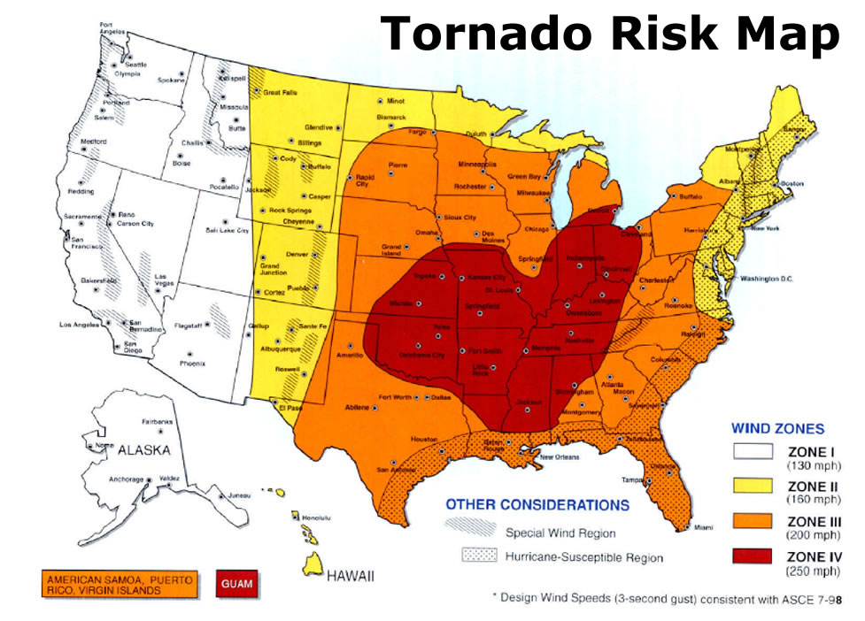
Storm Shelter
Notes:
Industrial park – hazardous materials releases
Rivers, lakes, oceans – floods, hurricanes
Railroad tracks – hazardous materials release, derailment
Wooded areas – wildfire
Nuclear power plant – radiological release
Steep slopes – landslide, avalanche
Stress that disasters can happen anywhere. 92% (check number) of all Americans live in areas that are prone to disasters, but no one is disaster proof. Floods can happen anywhere, including deserts and neighborhoods far from rivers and lakes when heavy rains flood streets and open areas faster than they can drain.

Slide 8
Storm Shelter Guidelines
 | Tornado | Hurricane
Put as many walls between yourself and the outside as you can | x | x
Go to the lowest safe level (winds are stronger at higher levels) | x | x
Close all interior doors | x | x
Shelter under a table or other sturdy object | x | x
Stay away from glass (even interior windows or glass fronted cabinets) | x | x
Don’t use elevators | x | x
Get underground if possible | x
Leave mobile homes or portable buildings to go to a safer location | x | x
Close blinds and curtains, cover windows with shutters if possible |  | x

Slide 9
Tornado vs. Hurricane
Tornadoes happen with much less warning than hurricanes. Don’t take the time to close (or open) windows or doors once a tornado warning is issued. Take shelter immediately.
Although both storms typically come with rain, hurricane rains are much heavier. Underground areas are prone to flooding, which can be as dangerous as the wind.
Notes:
Industrial park – hazardous materials releases
Rivers, lakes, oceans – floods, hurricanes
Railroad tracks – hazardous materials release, derailment
Wooded areas – wildfire
Nuclear power plant – radiological release
Steep slopes – landslide, avalanche
Stress that disasters can happen anywhere. 92% (check number) of all Americans live in areas that are prone to disasters, but no one is disaster proof. Floods can happen anywhere, including deserts and neighborhoods far from rivers and lakes when heavy rains flood streets and open areas faster than they can drain.

Slide 10
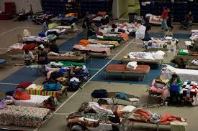
Emergency Evacuation Shelter
Emergency evacuation shelters are typically opened by the American Red Cross, the Salvation Army, or a government agency.

Slide 11
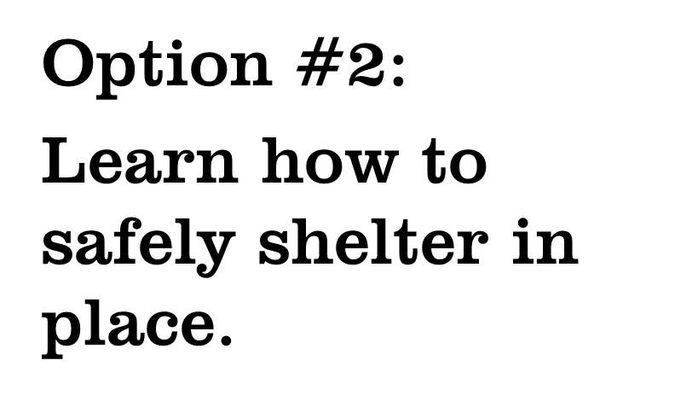
Notes:
Select the slides that apply to the area in which you are presenting.

Slide 12
Shelter in Place
Stay inside until the danger has passed
May be notified by outdoor warning sirens or Emergency Alert radio (also called NOAA Weather Radios)
Always follow emergency instructions

Slide 13
Important!
Never call 911 to get information in an emergency
Only call 911 when you need police, fire, or emergency medical assistance

Slide 14
Practice makes perfect
Talk to your family about your tornado shelter area. Make sure they know when and why to take shelter.
Practice getting to the area quickly. Don’t forget pets if you are planning to bring them in a tornado warning.
Practice staying in your tornado shelter area for 10 minutes to see if any problems arise.

Slide 15
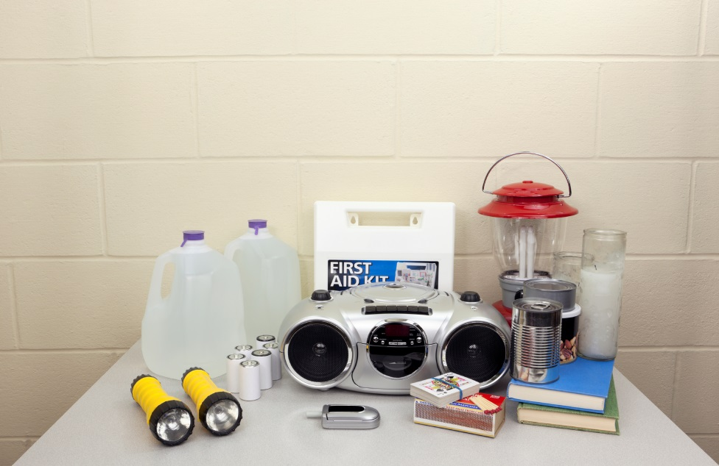

Slide 16
Make a Go Bag
Take your Go Bag with you to the shelter area inside your home if you have to shelter in place.
Take your Go Bag to the emergency evacuation shelter if you have to leave your home in a disaster.

Slide 17
Emergency Evacuation Shelters
Usually Provided | You Should Bring | NOT ALLOWED
Cots for sleeping | Pillows and blankets | Weapons
Meals and bottled water | Change of clothes | Alcohol
Nurse for basic medical care | Medication and medical supplies | Animals (except for service animals)
Information from public officials | Comfort items, magazines, cards, etc.
 | Identification
Shelters will usually not share your personal information with anyone, including the fact that you are safe at the shelter, unless you give them permission.

Slide 18
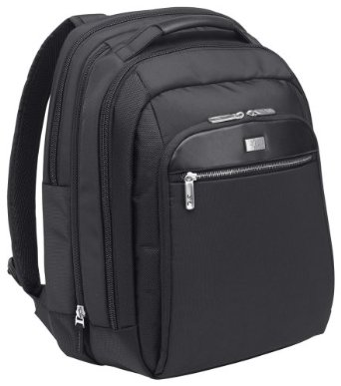
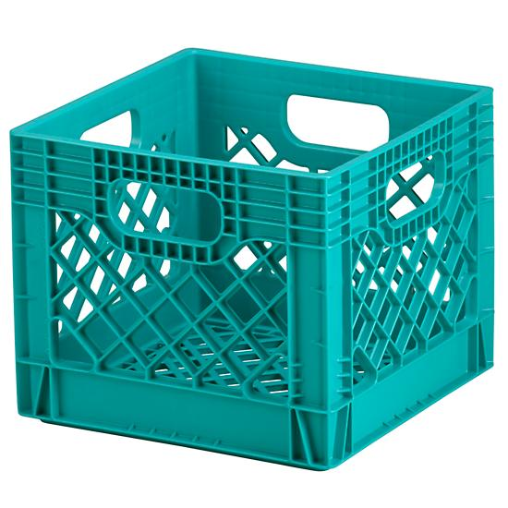
Go Bag
Notes:
A Go Bag can be in any container. It should be something that is easy to carry.

Slide 19
Go Bag Items
Medical Supplies
Comfort Items
Medication list with dosage, pharmacy name, and prescribing doctor
Doctors’ names and phone numbers
Medical supplies (catheters, insulin syringes, etc.)
Extra assistive devices (glasses, hearing aids, canes, etc.)
Batteries or chargers for assistive devices
Books and magazines
Cards
Coloring books and crayons
Toys
Chargers for phones or tablets
General
Change of clothing for each family member
Flashlight and extra batteries
Emergency information (including insurance policies)
Toothbrushes and toothpaste
Non-perishable snacks
Lightweight blankets
Battery powered radio
Bottled water
Identification
Drivers license or other photo ID
Photo IDs or copies of birth certificates for family members
Photos or microchip ID information for pets

Slide 20
Go Bag Items
Don’t forget to include specialty items for specific family members

Slide 21
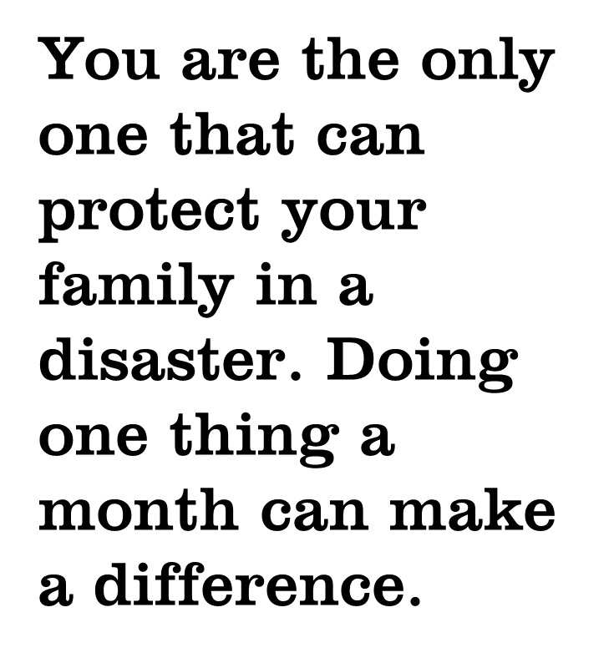

Slide 22
Next Month…
In a disaster you may not be able to get to the store. You may not have a stove or microwave for cooking.
Having an emergency food supply ready doesn’t have to be hard or expensive.
Find out how to make sure your family (including your pets) will have what they need when disaster strikes.

Slide 23
For more information
Presenter’s name
Contact Information
Contact Information
Do 1 Thing
http://www.do1thing.com
Email: contact@do1thing.com

