Slide 1
June: Unique Family Needs
Small steps to prepare your community for emergencies

Slide 2
Every household is different. If you have babies, or pets, or someone with a medical condition in your family you may need to take an extra step to make sure your household is prepared.

Slide 3
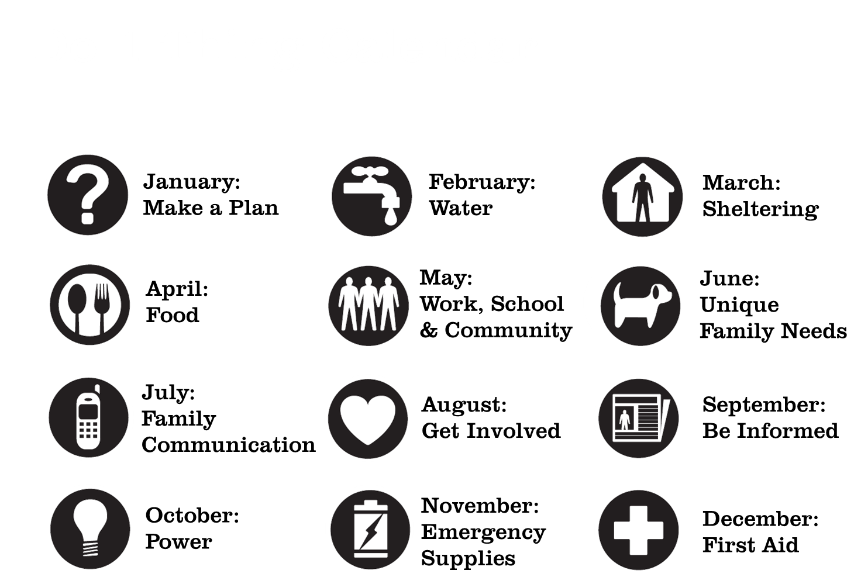

Slide 4
Why Do 1 Thing?
There may be many people who count on you every day. When a disaster happens, you may not be with them.
There are things you can do now to make sure they will be better prepared in a disaster, even if you can’t be with them.
Taking small steps now can help you be prepared even if you are not at home when disaster strikes.

Slide 5
Choose one thing to do this month
Talk with family members to identify your household’s unique needs.
Make a plan to make sure pets are taken care of in a disaster.
If someone in your household has a disability, create an evacuation plan that works for them.

Slide 6
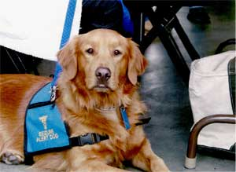
Option #1:
Talk with family members to identify your household’s unique needs.

Slide 7
Make a list
In an emergency it is easy to forget small, important items
Make a list of special items members of your family may need
Keep as many as you can in your Go Bag, along with a copy of the list

Slide 8
Babies/Small Children
Diapers
Bottles
Non-perishable food items, formula
Toys, books and comfort items
Medications or teething items

Slide 9
Medical Needs
List of medications, doses, who prescribed, and pharmacy where they are normally filled
Extra batteries or chargers for hearing aids, scooters, or wheel chairs
Spare pair of glasses
Description of special diet, food scale, measuring cups/spoons, and non-perishable food items

Slide 10
Pets
Picture of pet and copy of medical records
Extra leash/harness and collar
Toy or comfort item
Extra dishes
Non-perishable food

Slide 11
Option #2:
Make a plan to make sure pets are taken care of in a disaster.
Notes:
Select the slides that apply to the area in which you are presenting.

Slide 12
Making a plan
Disasters can happen when you are away from home. You may not be able to get into your neighborhood to pick up pets.
Think about asking a trusted neighbor to check on your pets if you can’t get home

Slide 13
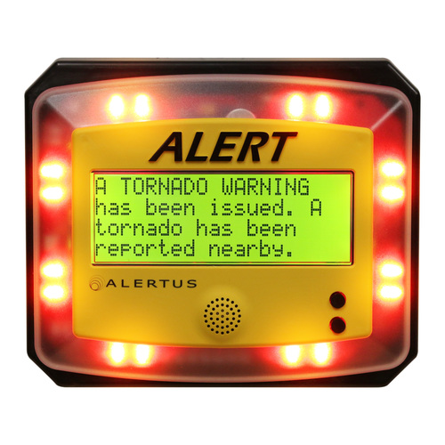
Option #3: If someone in your household has a disability, create an emergency plan that works for them.

Slide 14
Evacuation Planning
Make sure you are signed up for emergency alert systems offered by your community.
Talk to your paratransit provider about what services they can provide if an evacuation is ordered.
Talk to your local Red Cross or other organization that provides emergency shelter. Make sure your needs can be met in a shelter.

Slide 15
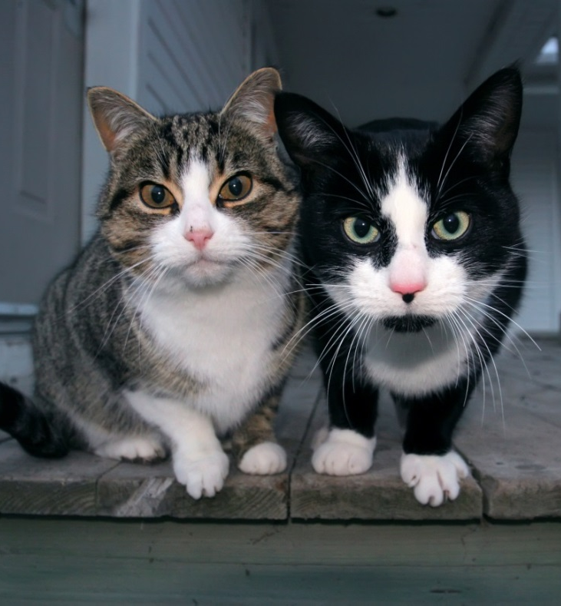
You are the expert on your family’s needs. Think ahead about how disaster will affect those you care for and take steps to be ready for whatever happens.

Slide 16
Next Month…
July: Family Communication
We count on our cell phones and internet service to stay in touch every day.
If the power goes out or phone service is lost, know how you will get in touch with those you care about, and how you will let them know you’re okay.

Slide 17
For more information
Presenter’s name
Contact Information
Contact Information
Do 1 Thing
http://www.do1thing.com
Email: contact@do1thing.com

