Slide 2
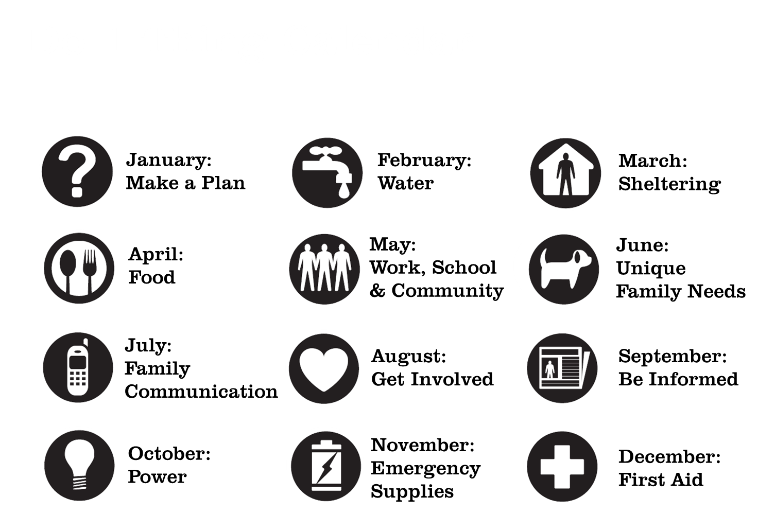

Slide 4
Why make a plan?
Disasters change things. When an emergency happens you may have to decide what to do very quickly, while you are worrying about what might happen.
By planning ahead, it will be easier to make the right decisions when the worst happens.

Slide 5
Disasters change things
During an emergency or a disaster:
You might not know for sure what is going on (how long will it last, what you should do, what others are going to do)
You might not have things that you are used to having (like electricity, ATM machines, gas stations, or cellular phone service)
You may not be able to contact family members or friends.

Slide 6
Disasters change things
Planning ahead makes it easier for you and members of your family to make the right decisions in an emergency.

Slide 7
Choose one thing to do this month:
Learn what disasters can happen in your area and decide what you will do in a disaster.
Take steps now to prevent damage to your home in a disaster.
Plan what to do if you have to evacuate.

Slide 8
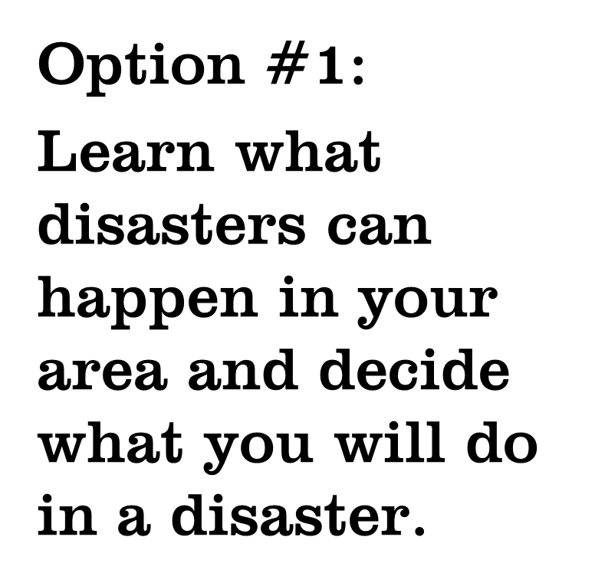
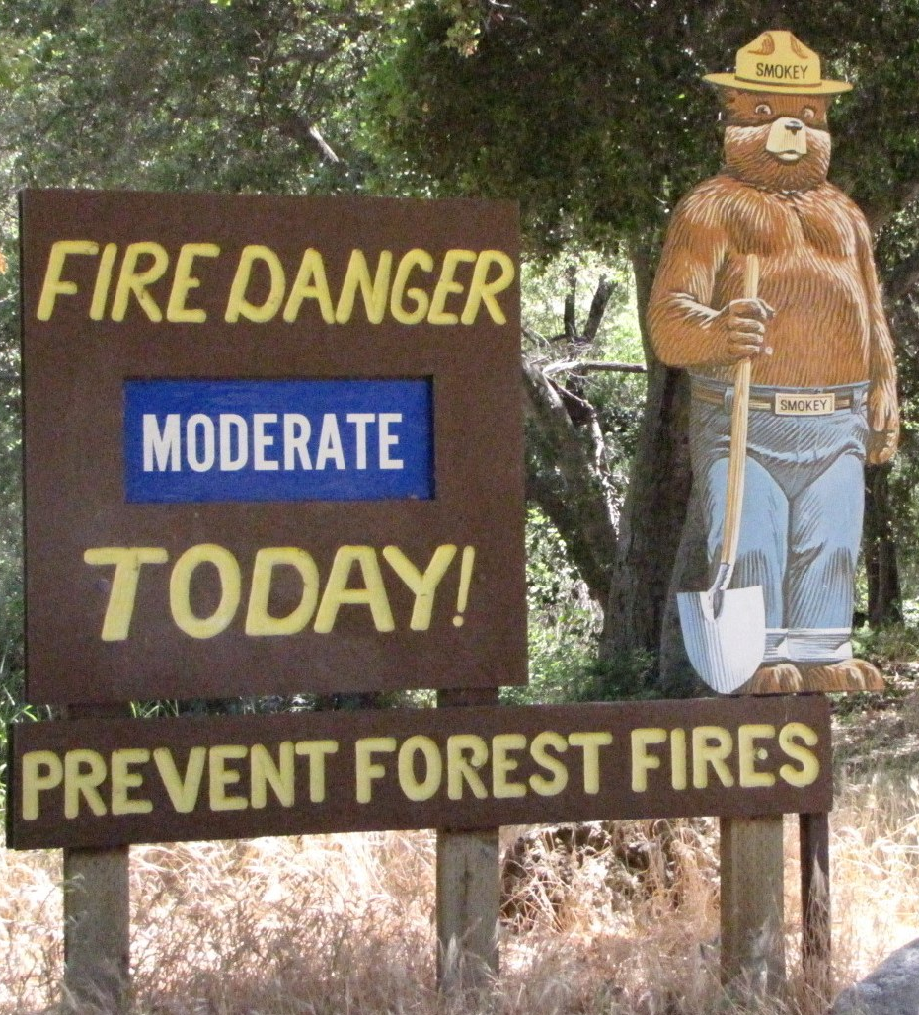

Slide 9
Understanding your risk
What can happen in your community?
What could happen in your neighborhood?
Tornado
Flood
Earthquake
Wildfire
Hurricane
Landslide

Slide 10
Do I live near…
An industrial park?
A river, lake or ocean?
Railroad tracks or highways?
Large wooded area?
Nuclear power plant?
Steep slopes?
Notes:
Industrial park – hazardous materials releases
Rivers, lakes, oceans – floods, hurricanes
Railroad tracks – hazardous materials release, derailment
Wooded areas – wildfire
Nuclear power plant – radiological release
Steep slopes – landslide, avalanche
Stress that disasters can happen anywhere. 92% (check number) of all Americans live in areas that are prone to disasters, but no one is disaster proof. Floods can happen anywhere, including deserts and neighborhoods far from rivers and lakes when heavy rains flood streets and open areas faster than they can drain.

Slide 11
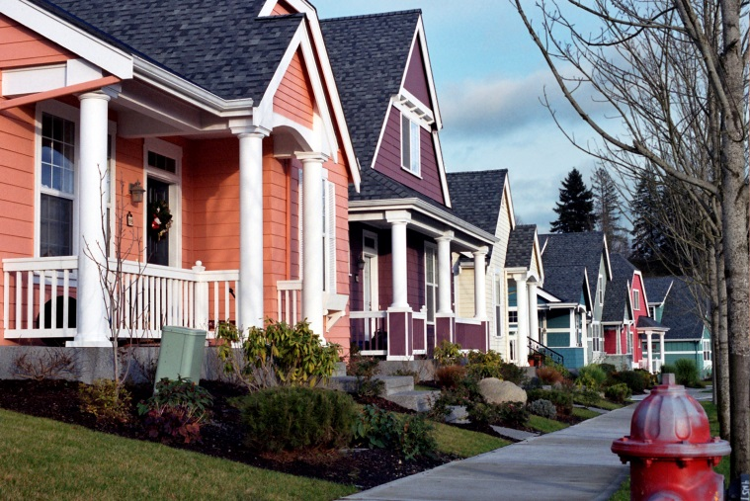
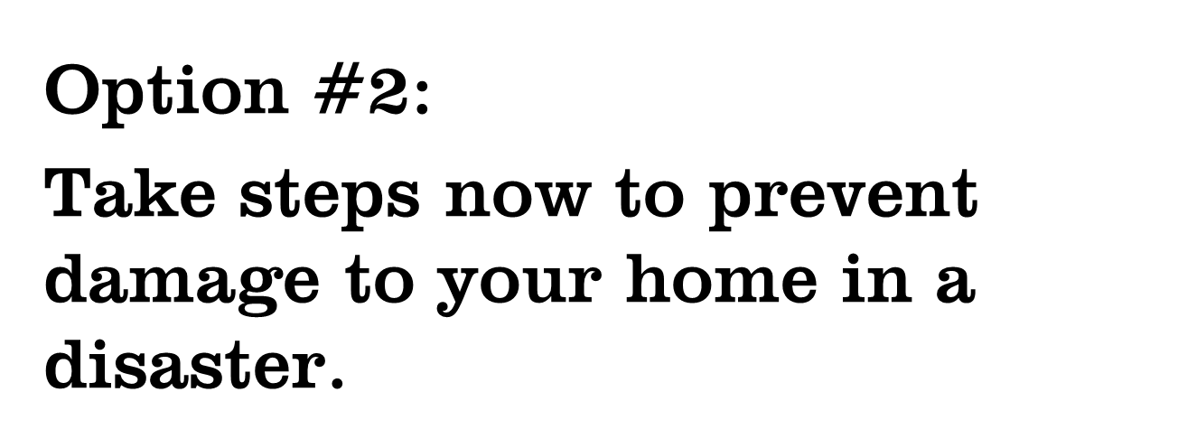
Notes:
Select the slides that apply to the area in which you are presenting.

Slide 12
Tornado
Brace or strap the roof of your home.
Reinforce entry and overhead doors.
Remove tree branches that could fall on your home or on power lines.
Secure outdoor furniture when a tornado watch is issued.
Consider adding a tornado safe room to your home.
Notes:
For additional information and handouts visit: https://www.disastersafety.org/commercial_maintenance/steps-to-reduce-the-risk-of-tornado-damage_ibh/

Slide 13
Flood
Elevate your home so that the lowest floor is one foot or more above the base flood elevation.
Use flood-resistant materials when you build or remodel.
Store valuables on upper floors, above the base flood elevation.
Use native plants in landscaping to reduce stormwater runoff.

Slide 14
Earthquake
Assess your home for structural weaknesses, like unreinforced masonry walls or unbraced pier and post foundations.
Make sure tall or heavy items in your home are secured with earthquake fasteners.
Relocate valuable items to lower shelves or cabinets with latched doors.
Notes:
For additional information and handouts visit; https://www.fema.gov/earthquake/earthquake-safety-home

Slide 15
Wildfire
Remove dead vegetation within 10 feet of your house and avoid placing firewood or propane tanks in that area.
Trim back trees that overhang your roof.
Prune trees so that there are no branches within 6-10 feet of the ground.
Use fire resistant plants in landscaping.
Notes:
For additional information and handouts visit :http://firewise.org/wildfire-preparedness.aspx?sso=0

Slide 16
Hurricane
Install hurricane shutters on windows and glass entry doors.
Seal your roof and protect vents to prevent water from entering your home.
Reinforce foundation and roof connections.
Reinforce entry and overhead doors.
Notes:
For additional information and handouts, visit: http://www.floridadisaster.org/Mitigation/RCMP/index.htm

Slide 17
Insurance
Not all damage can be prevented.
Having the right insurance is your best bet for getting your home back to normal quickly after a disaster.
If you rent, find out about renter’s insurance.

Slide 18
Insurance
Some hazards aren’t covered under most homeowner insurance policies.
Flood
Hurricane
Earthquake
Landslide
Talk to your insurance agent about what is covered by your policy.

Slide 19
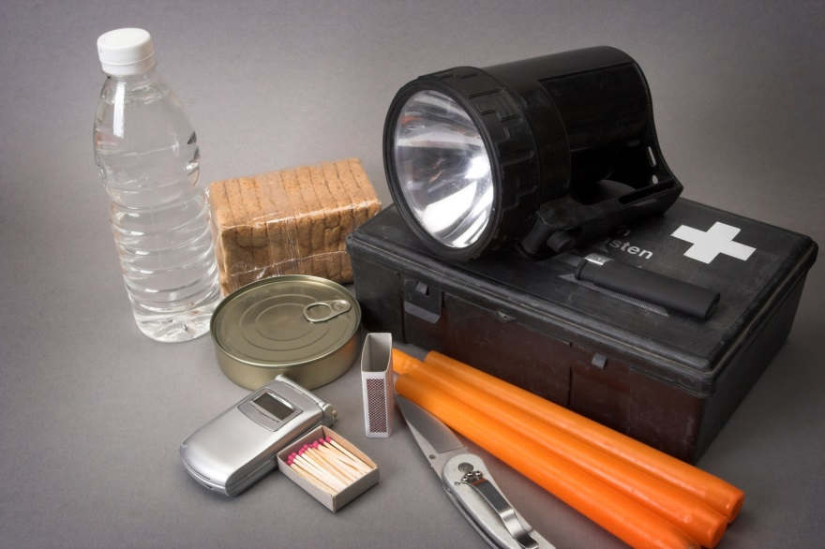

Slide 20
Types of Evacuation
Outside of your house (fire, gas leak…)
Outside of your neighborhood (wildfire, gas main break…)
Outside of your community (hurricane, hazardous material spill…)

Slide 21
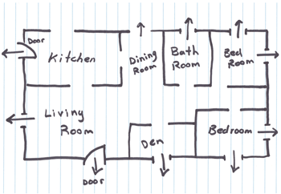
Outside of your house

Slide 22
Outside of your neighborhood
If the evacuation happens when you’re not home:
Select a meeting place outside of your neighborhood that everyone can go to.
Make sure it is familiar (like a relative’s house or favorite restaurant)
Make sure it is near public transportation
Plan to have someone else in the neighborhood evacuate your pets

Slide 23
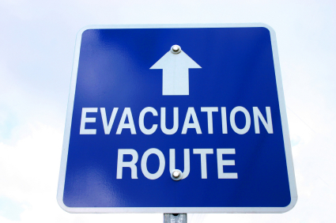
Outside of your community
Find out if your community has designated evacuation routes.
Always follow emergency instructions, even if you think you know a better route. Planners may have information that you don’t.

Slide 24
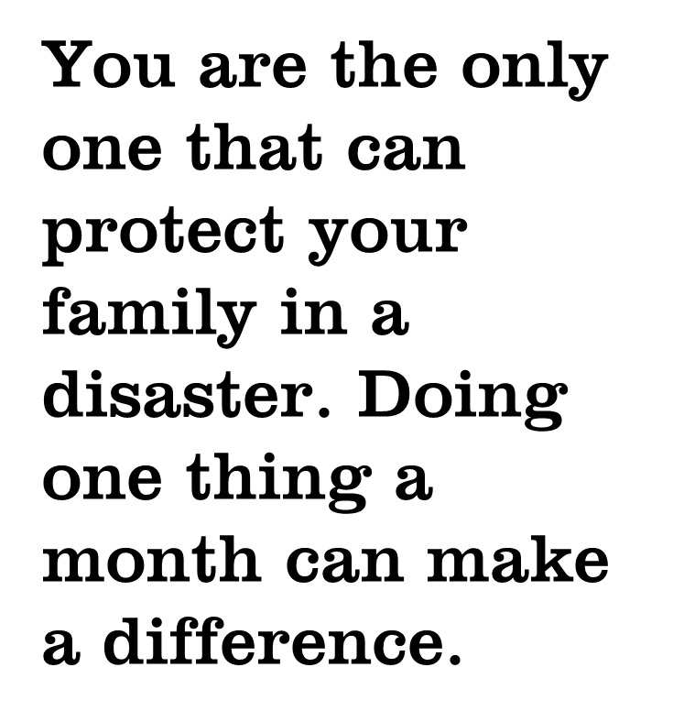

Slide 25
Next Month…
Whether you live in the country or the city, your water supply relies on electricity to run the system. During a power outage you may find yourself without a way to get water.
Water supplies can also become unsafe to drink. Both private wells and city water systems can be contaminated in a disaster.

Slide 26
For more information
Presenter’s name
Contact Information
Contact Information
Do 1 Thing
http://www.do1thing.com
Email: contact@do1thing.com

