Slide 2
Disasters change things. Things that we take for granted every day may be hard to find.

Slide 3
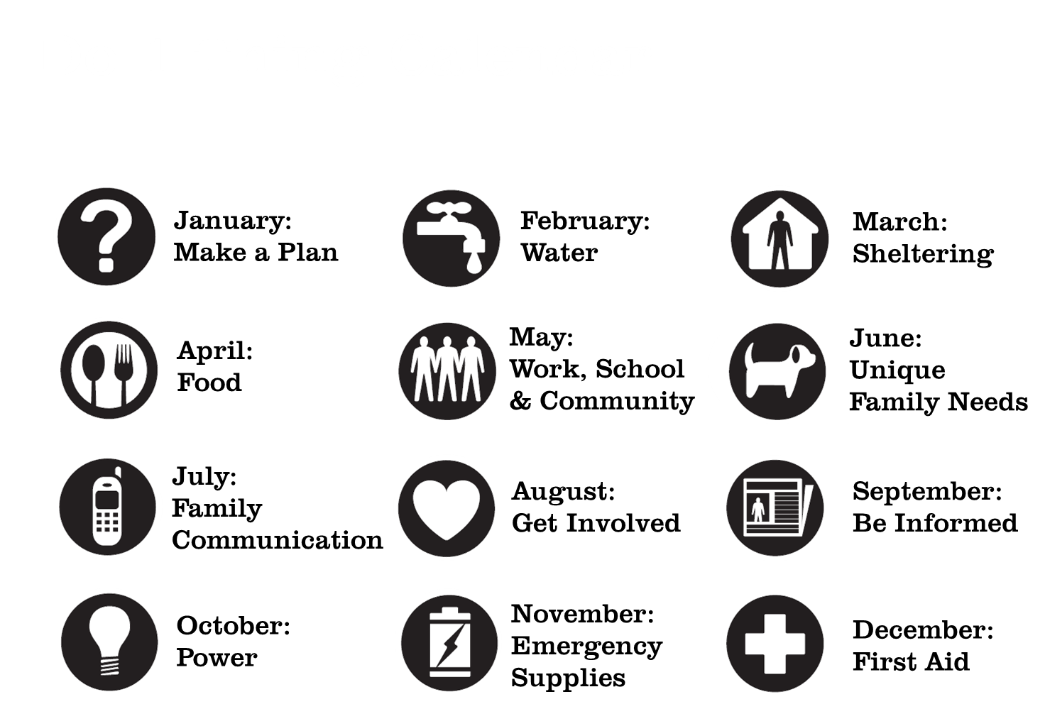

Slide 4
Why water?
Whether you live in the country or the city, your water supply relies on electricity to run the system. During a power outage you may find yourself without a way to get water.
Your water supply can also become unsafe to drink. Both private wells and city water systems can be contaminated in a disaster.

Slide 5
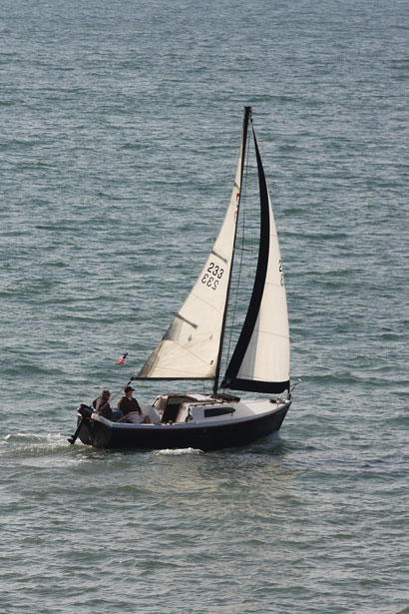
Disasters change things
It’s not necessarily that people don’t believe that disaster will happen, it’s that they underestimate the impact and overestimate their ability to handle it when it does.
Notes:
There is a saying in sailing that if you are asking if it’s time to lower the main sail in high wind, it’s already too late. Inexperienced sailors often make the mistake of waiting too long to lower the sail, not because they don’t believe that the wind is rising, but they believe that they’ll be able to handle it when it comes.

Slide 6
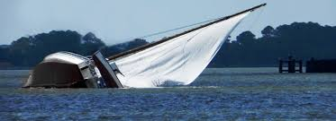
Disasters change things
Disasters can happen in an instant.
Little information available
Hard to make decisions
You may not know what is going to happen next.
Notes:
There is a saying in sailing that if you are asking if it’s time to lower the main sail in high wind, it’s already too late. Inexperienced sailors often make the mistake of waiting too long to lower the sail, not because they don’t believe that the wind is rising, but they believe that they’ll be able to handle it when it comes.

Slide 7
Choose one thing to do this month
Purchase and store a 72-hour supply of commercially bottled water (or more – up to two weeks).
Bottle a 72-hour supply of water at home.
Learn how to provide a safe supply of drinking water for your household in a disaster.

Slide 8
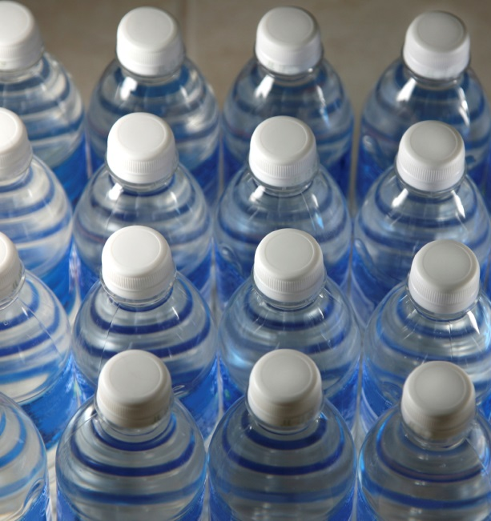
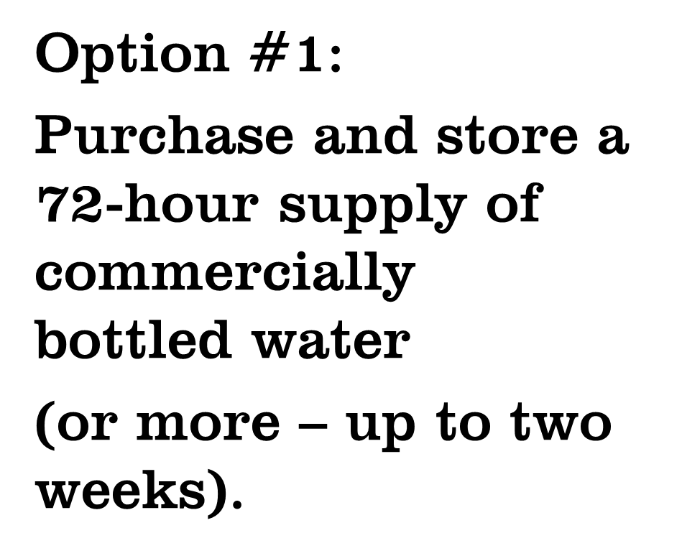

Slide 9
Emergency Water Supply
Plan for 1 gallon per person per day for drinking and hygiene
During a disaster you should drink at least one half gallon of water a day, more if:
You are pregnant
You are sick
The weather is hot
You are a child
72 hours = 3 days
Notes:
Industrial park – hazardous materials releases
Rivers, lakes, oceans – floods, hurricanes
Railroad tracks – hazardous materials release, derailment
Wooded areas – wildfire
Nuclear power plant – radiological release
Steep slopes – landslide, avalanche
Stress that disasters can happen anywhere. 92% (check number) of all Americans live in areas that are prone to disasters, but no one is disaster proof. Floods can happen anywhere, including deserts and neighborhoods far from rivers and lakes when heavy rains flood streets and open areas faster than they can drain.

Slide 10
How much water?
People | 1 day | 2 days | 3 days | 4 days | 5 days | 6 days | 7 days
1 | 1 | 2 | 3 | 4 | 5 | 6 | 7
2 | 2 | 4 | 6 | 8 | 10 | 12 | 14
3 | 3 | 6 | 9 | 12 | 15 | 18 | 21
4 | 4 | 8 | 12 | 16 | 20 | 24 | 28
5 | 5 | 10 | 15 | 20 | 25 | 30 | 35
6 | 6 | 12 | 18 | 24 | 30 | 36 | 42
7 | 7 | 14 | 21 | 28 | 35 | 42 | 49
8 | 8 | 16 | 24 | 32 | 40 | 48 | 56
9 | 9 | 18 | 27 | 36 | 45 | 54 | 63
10 | 10 | 20 | 30 | 40 | 50 | 60 | 70
Pets
1 Small to Medium | 1 | 1 | 1 | 1 | 2 | 2 | 2
1 Large | 1 | 2 | 3 | 4 | 5 | 6 | 7

Slide 11
Emergency Water Supply
Mark the date on your bottled water.
Replace it at least once a year
TIP: Replace it before the year is up so that you can use up the older water and it doesn’t go to waste

Slide 12
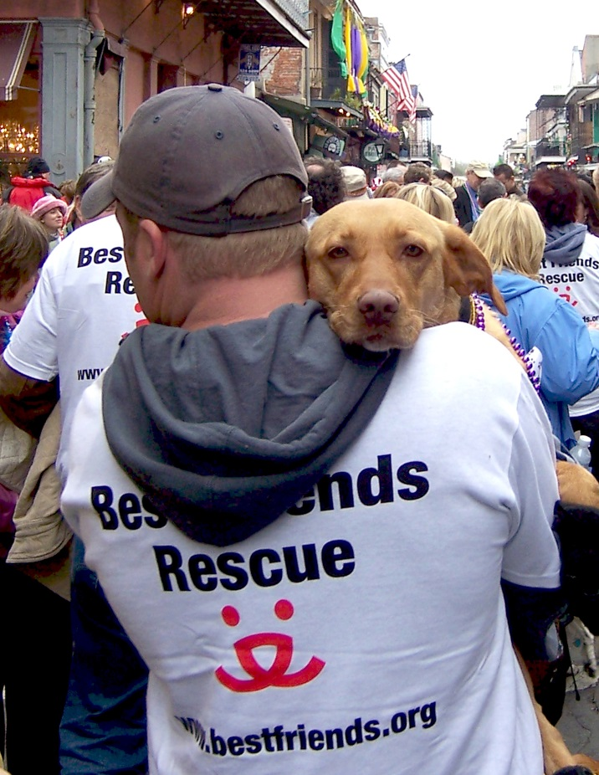
Pets and disaster
Remember that disaster can be stressful for pets too
Animals may need more water when they are under stress
Pack a water dish or bottle for your pets in your emergency kit

Slide 13
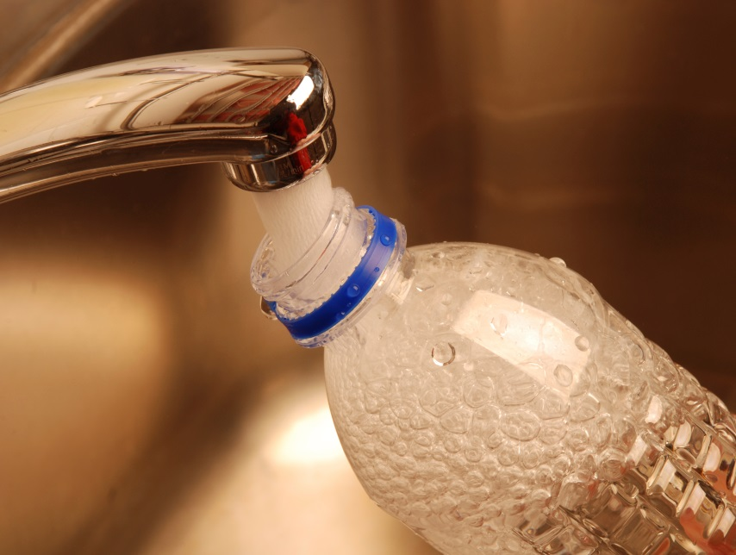
Notes:
Select the slides that apply to the area in which you are presenting.

Slide 14
Bottling Water at Home
Use clear plastic or glass bottles (2 liter soda bottles = yes, milk jugs = no)
Wash and rinse containers well
Allow to air dry

Slide 15
Bottling Water at Home
If your water comes from a well:
Add 6 drops of bleach to each gallon of water
Allow to sit for 30 minutes before filling or closing the bottle
If you have city water you can skip this step.

Slide 16
Bottling Water at Home
Cap bottles tightly and store out of direct sunlight
Mark the date on each bottle

Slide 17
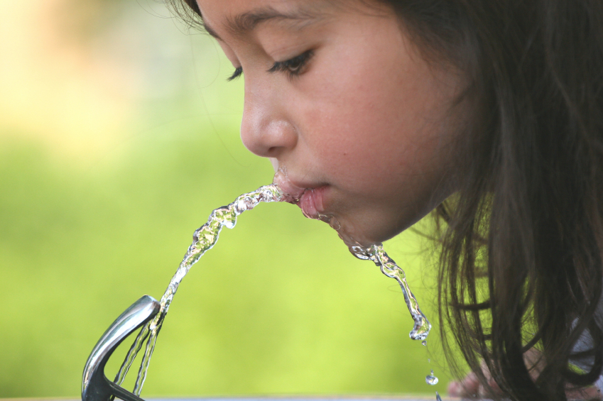
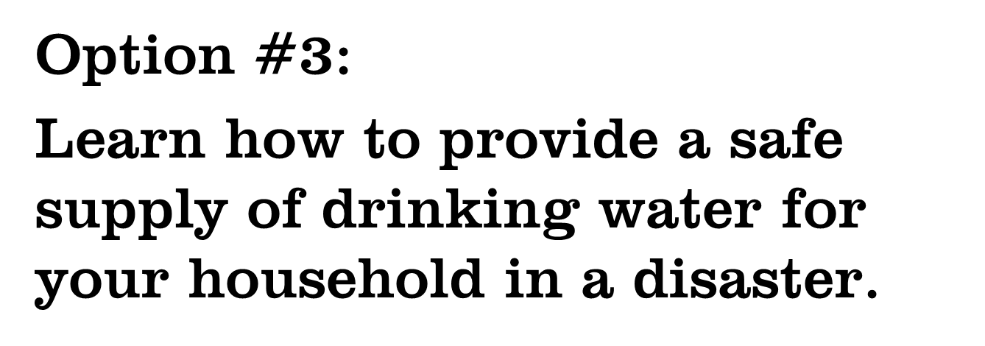

Slide 18
Safe Drinking Water
If your local water supply becomes contaminated you may be told to boil water before using, or you may be given other instructions
Boiling water can remove harmful bacteria and other organisms
If water is contaminated by chemicals boiling will not make it safe
Always follow emergency instructions!

Slide 19
Safe Drinking Water
Water in your water heater tank (do not use if the tank or fixtures have been submerged in flood water)
Turn off the gas or electricity to the water heater
Turn off the water intake valve
Open the drain at the bottom of the tank
Turn on a hot water faucet all the way

Slide 20
Safe Drinking Water
Water standing in pipes
Turn off the main water valve where the water comes into your house (usually near the water meter if you have city water)
Let air into the pipes by turning on the highest faucet in your house
Get water from the lowest faucet in your house (never get water from faucets that have been submerged in flood water

Slide 21
Safe drinking water
If you have room in your freezer, consider storing part of your water supply as ice.
When your freezer is full it takes less energy to keep it cold.
It will also keep your freezer colder longer in a power outage.
Replace ice every 6 months to avoid it developing a bad taste.

Slide 22
Safe Drinking Water
Lakes, rivers and streams
Always treat water from an outdoor source as though it is contaminated
Most outdoor water supplies contain chemicals from stormwater runoff and also contain organisms that might be harmful
Purification tabs and emergency filtration systems are available at most stores that sell camping supplies

Slide 23
Important!
Never ration water. Always drink as much as you need today and look for more tomorrow.

Slide 24
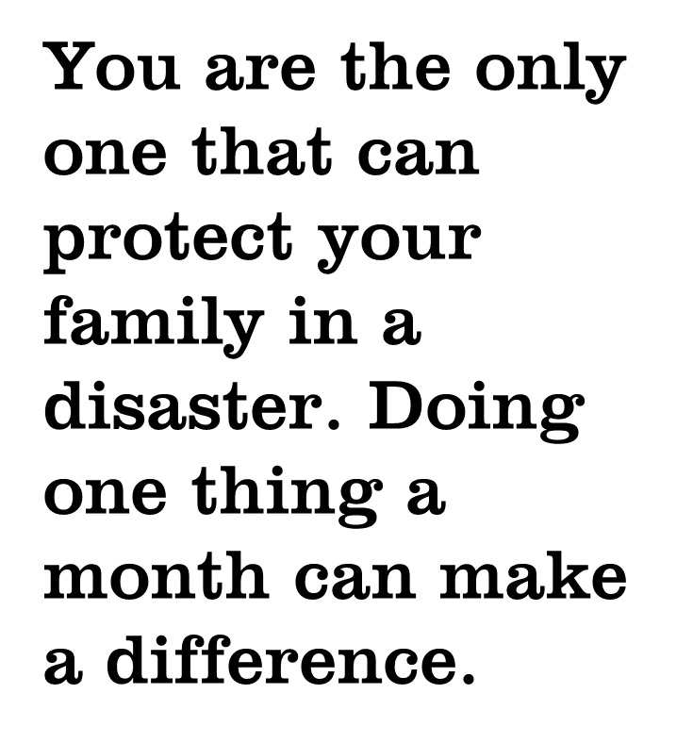

Slide 25
Next Month…
In a disaster you may be asked to either evacuate or shelter in place.
In the excitement of an emergency it can be difficult to focus on what you are doing.
Find out what to do to keep your family safe.

Slide 26
For more information
Presenter’s name
Contact Information
Contact Information
Do 1 Thing
http://www.do1thing.com
Email: contact@do1thing.com

