Slide 1
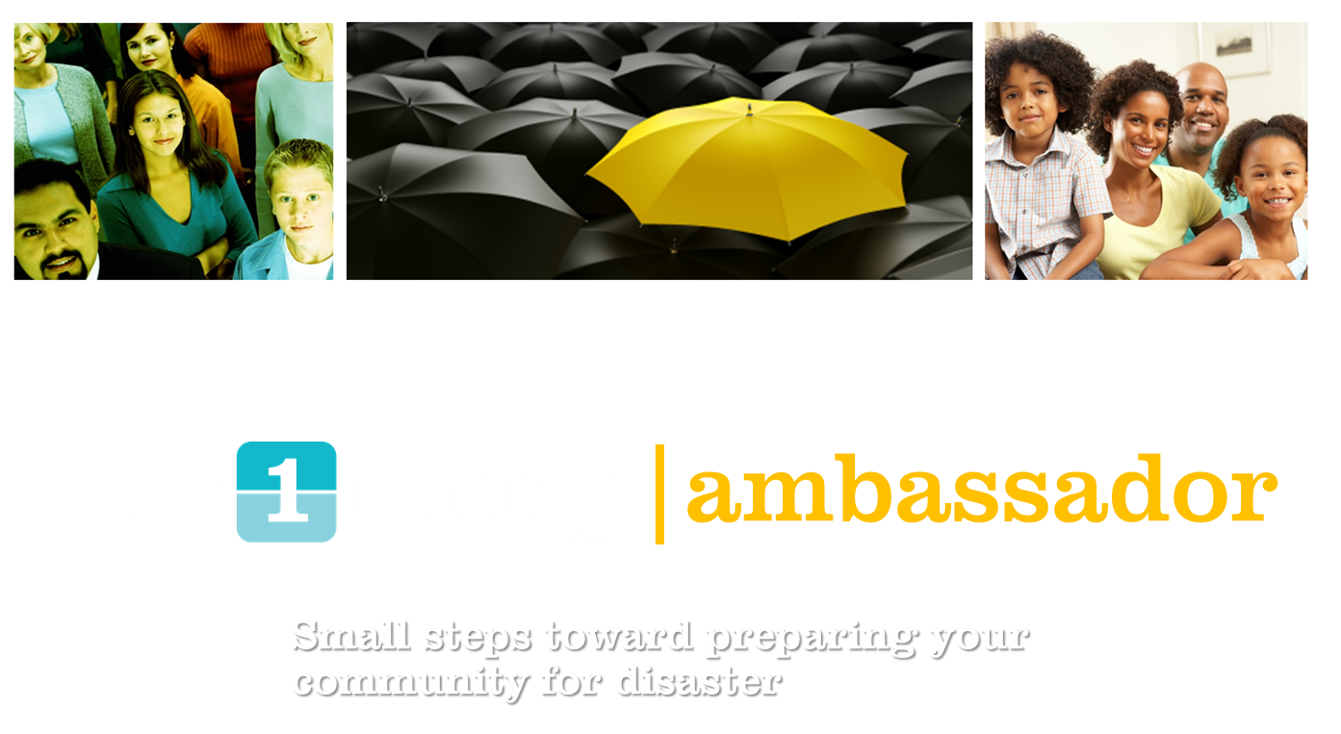
Notes:
Want to talk about three things:
This concept of whole community emergency management
Do 1Thing, which is an emergency preparedness program
And how you can apply the information from Do 1 Thing as CERT members before during and after a disaster, to achieve whole community emergency management

Slide 2
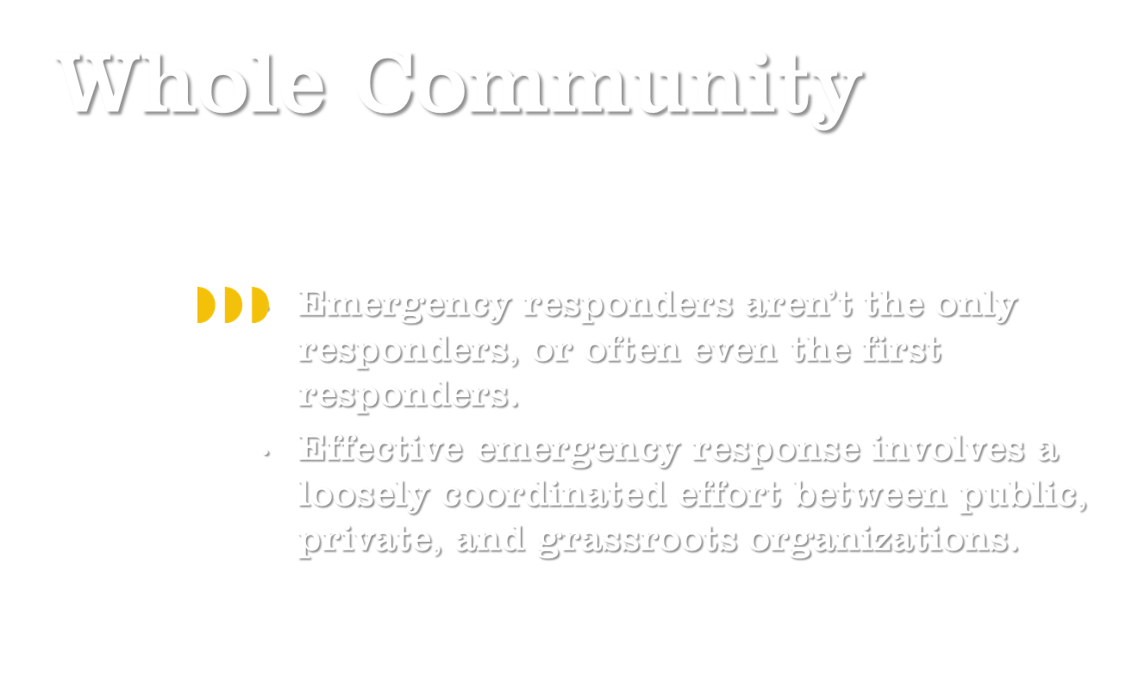
Notes:
Through the process of emergency management (four phases) there are a number of different private and public players
Why loosely coordinated?
Benefits – different priorities (example of people restoring NO musical heritage post-Katrina), different resource streams, fewer limitations
Here’s another question – why coordinated?
Avoiding overlapping services and unmet needs
Building a sense of community and not competition
Consistent information

Slide 15
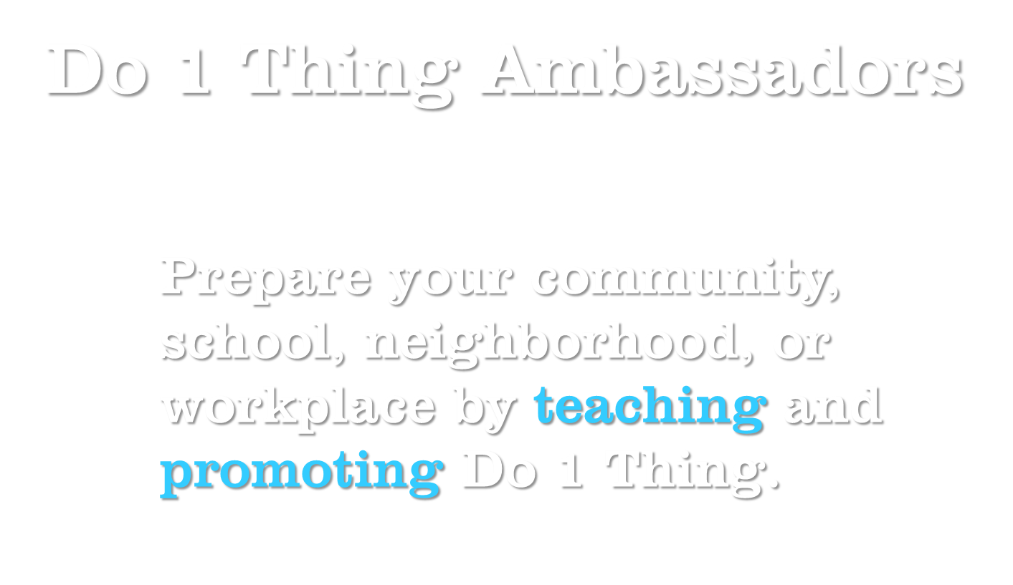

Slide 16
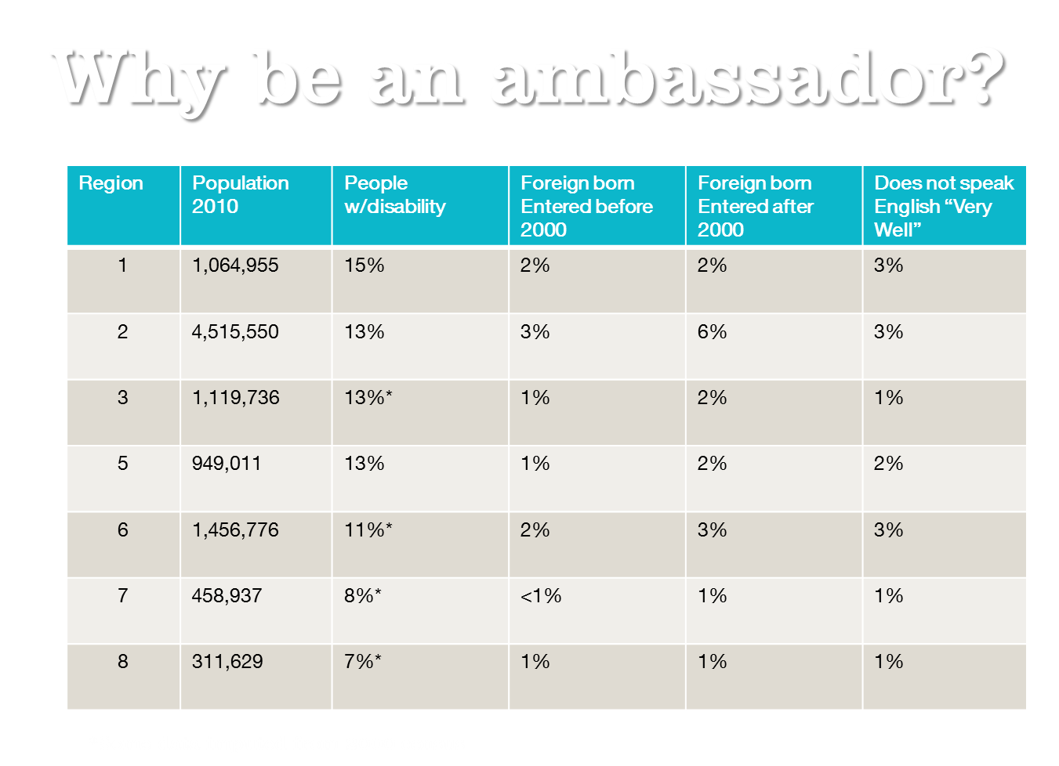

Slide 17
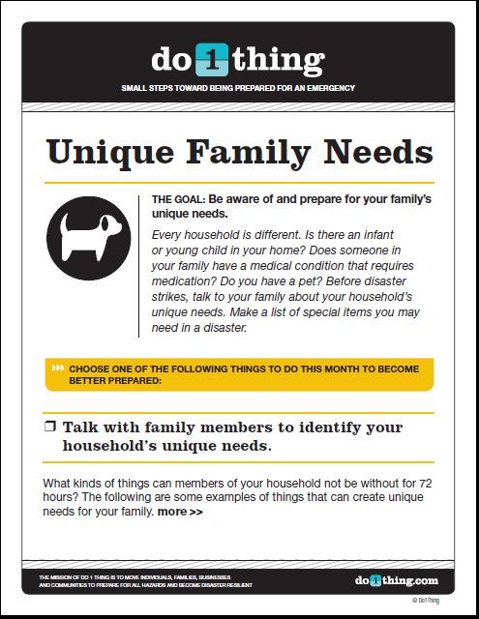
Accessibility: Visual
Materials are available in
Braille
Large Print
Audio file

